Slide 1
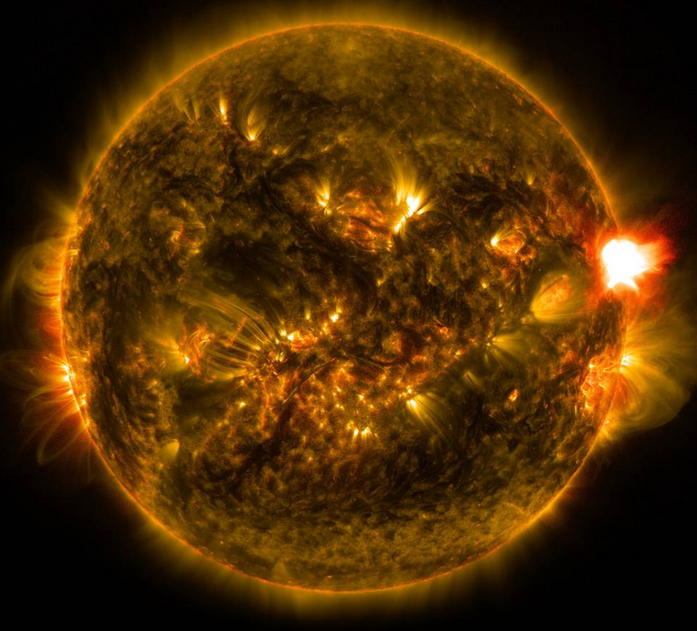
The BIGGEST Didgeridoo EVER!

Slide 2
